Slide 1
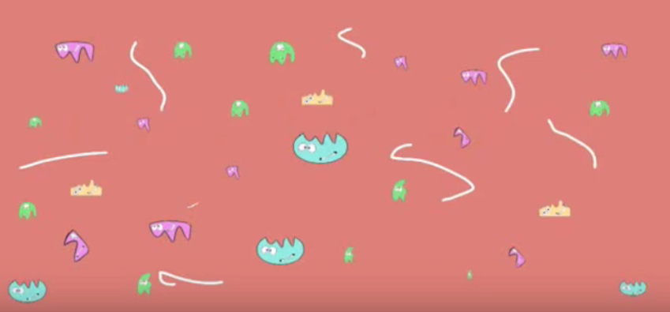
Enzymes: How do changes in temperature and pH affect enzyme activity?

Slide 2
What were some strengths of the way you planned or carried out your investigation?
(What made it scientific?)

Slide 3
What were some weaknesses of the way you planned and carried out your investigation?
(What made it less scientific?)

Slide 4
What rules should we make in order to ensure that our next investigation is scientific?

Slide 5
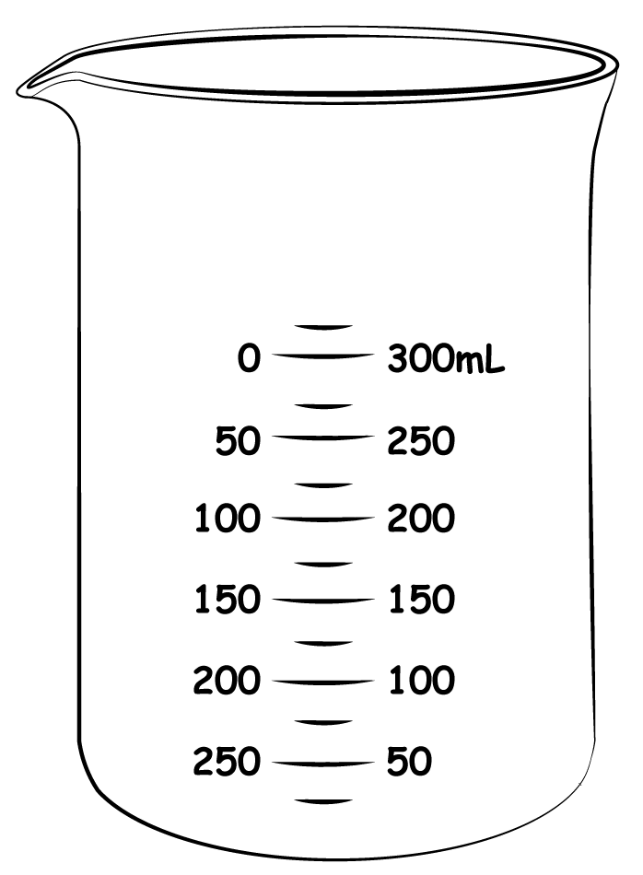
5mL H₂O₂ + 1mL distilled water
5mL H₂O₂ + 1mL boiled catalase
Describe the control groups, what they control for, and why they are necessary

Slide 6
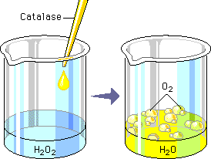
Explain what is illustrated
Was this a chemical change or physical change?
How do you know when a chemical change occurs?
How do you know when a physical change occurs?

Slide 7
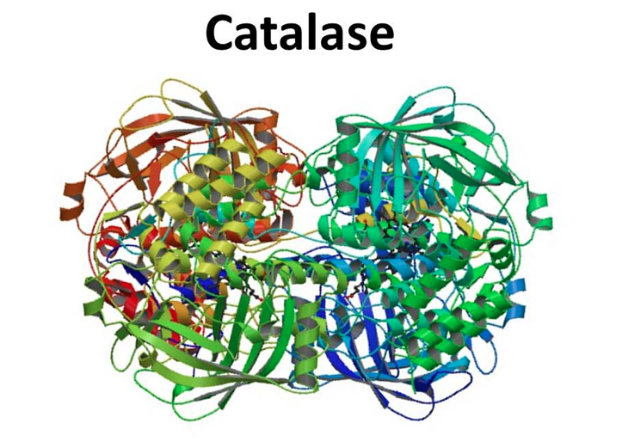
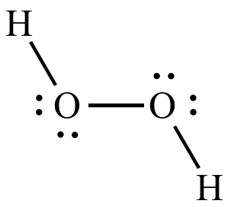
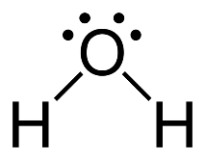
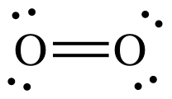
Write down 5 observations

Slide 8
Explain what’s illustrated

Slide 9
The enzyme catalase speeds up the reaction but does not get used up in the reaction
Reactants: 2 hydrogen peroxide molecules (4 oxygen atoms and 4 hydrogen atoms)
Products: 2 water molecules and 1 oxygen molecule (4 oxygen atoms and 4 hydrogen atoms)
Total amount of atoms (matter) stays the same

Slide 10
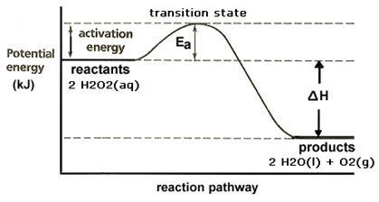
Explain what’s illustrated
Potential Energy + Kinetic energy

Slide 11
What evidence would support the claims made in the circled portions of the illustration?
Potential Energy + Kinetic energy

Slide 12
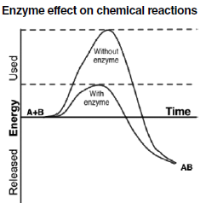
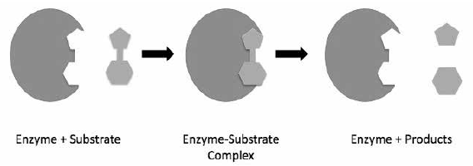
Write down 5 observations
Potential Energy + Kinetic energy

Slide 13
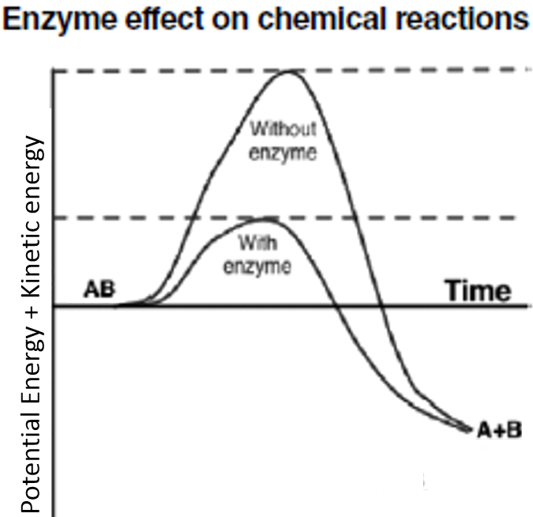
Explain what’s illustrated

Slide 14
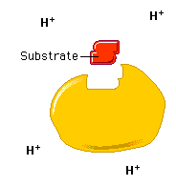
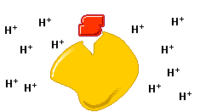
Explain what’s illustrated

Slide 15
Explain what’s illustrated
21°C
37°C

Slide 16
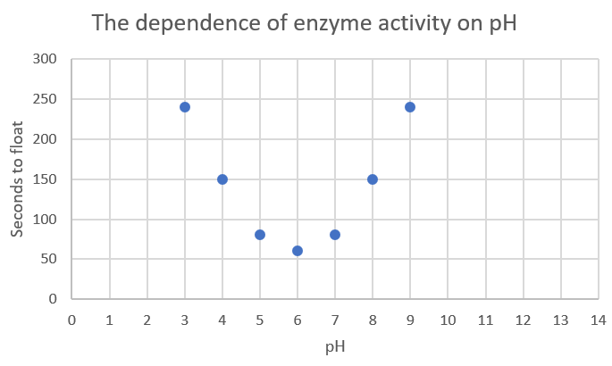
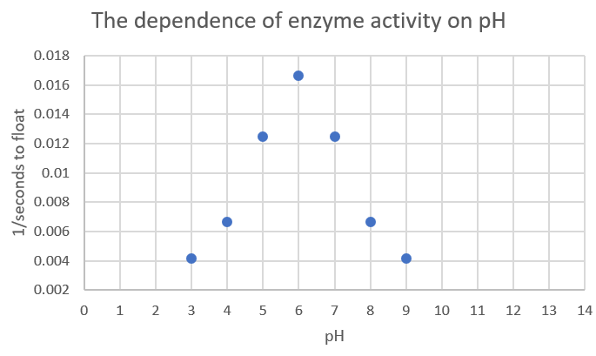
Write at least 3 similarities and 3 differences between the 2 graphs

Slide 17
What is the dependent variable of each graph?
What is the independent variable of each graph?

Slide 18
Explain how these two apparently inverse graphs are illustrating the exact same data
Which graph do you think illustrates the data best and why?

Slide 19
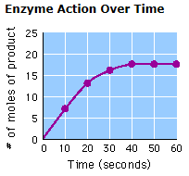
What does rate mean?
Calculate the rate of oxygen production at 15 seconds
Calculate the rate of oxygen production at 45 seconds

Slide 20
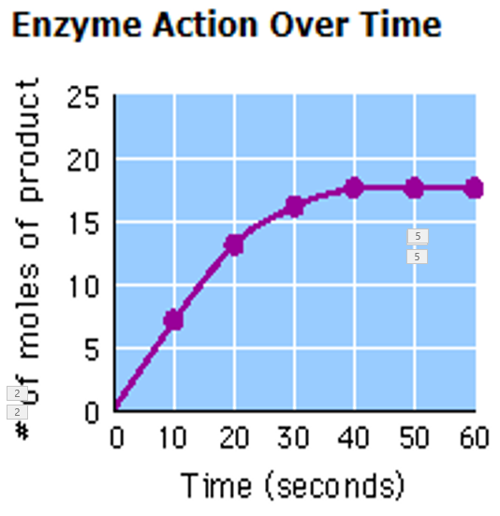
$$m=slope=rate of change=enzyme activity$$
$$m=\frac{Δy}{Δx}=\frac{y_{2}−y_{1}}{x_{2}−x_{1}}=\frac{rise}{run}$$
$$\frac{rise}{run}=$$
10.1mol
=
0.67mol/sec
15sec

Slide 21
$$m=slope=rate of change=enzyme activity$$
$$m=\frac{Δy}{Δx}=\frac{y_{2}−y_{1}}{x_{2}−x_{1}}=\frac{rise}{run}$$
$$\frac{rise}{run}=$$
10.1mol
=
0.67mol/sec
15sec
Compare the rate of O₂ production at point A to point B:
Is the rate higher, lower, or equal?
B
A

Slide 22
$$m=slope=rate of change=enzyme activity$$
$$m=\frac{Δy}{Δx}=\frac{y_{2}−y_{1}}{x_{2}−x_{1}}=\frac{rise}{run}$$
$$\frac{rise}{run}=$$
10.1mol
=
0.67mol/sec
15sec
$$\frac{rise}{run}=$$
5mol
=
0.63mol/sec
8sec
The difference is due to estimation error. The line doesn’t cross the (10.1,15) and (5,8) coordinates exactly.

Slide 23
$$m=slope=rate of change=enzyme activity$$
$$m=\frac{Δy}{Δx}=\frac{y_{2}−y_{1}}{x_{2}−x_{1}}=\frac{rise}{run}$$
Compare the rate of O₂ production at point B to point C:
Is the rate higher, lower, or equal?
C
B

Slide 24
Calculate the rate of oxygen production at 45 seconds
$$m=\frac{Δy}{Δx}=\frac{y_{2}−y_{1}}{x_{2}−x_{1}}=\frac{rise}{run}$$
$$\frac{y_{2}−y_{1}}{x_{2}−x_{1}}=\frac{17.5mol−17.5mol}{50sec−45sec}$$
$$\frac{0mol}{5sec}=0mol/sec$$
You must include average rate of enzyme activity O₂ppm/sec

Slide 25
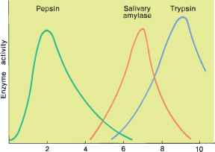
Make 5 observations (pepsin, amylase, and trypsin) are all enzymes
Enzyme Activity (product/sec)
pH

Slide 26
Explain what’s illustrated
Enzyme Activity (product/sec)
pH

Slide 27
Pepsin is an enzyme that cleaves proteins (polypeptides) into smaller polypeptides
Amylase is an enzyme that cleaves starch (a polysaccharide) into maltose (a disaccharide)
Enzyme Activity (product/sec)
Trypsin is an enzyme that cleaves polypeptides into smaller peptides
pH

Slide 28
Where do you think you would find these enzymes in the human body?
What do you think the pH set point is in these parts of the body?
Enzyme Activity (product/sec)
pH

Slide 29
Describe the enzyme activity of trypsin if it were found in the stomach
Justify your answer to the previous question. A justification has 3 components: 1) Scientific knowledge and/or theory; 2) specific data from your analysis related to the knowledge; and 3) an explanation of how the data relates to the knowledge.
Enzyme Activity (product/sec)
pH

Slide 30
Crosscutting concepts in science
Cause and effect: Mechanism and Prediction
How was the following demonstrated in this lab?
Empirical evidence is required to differentiate between cause and correlation and make claims about specific causes and effects.
Cause and effect relationships can be suggested and predicted for complex natural and human designed systems by examining what is known about smaller scale mechanisms within the system.

Slide 31
Crosscutting concepts in science
Energy and matter: Flows, Cycles, and Conservation
How was the following demonstrated in this lab?
Changes of energy and matter in a system can be described in terms of energy and matter flows into, out of, and within that system.
Energy drives the cycling of matter within and between systems.

Slide 32
Crosscutting concepts in science
Structure and Function
How was the following demonstrated in this lab?
The functions and properties of natural and designed objects and systems can be inferred from their overall structure, the way their components are shaped and used, and the molecular substructures of its various materials.

