Slide 1
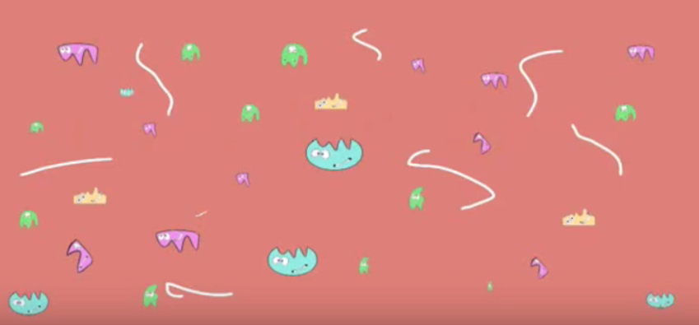
Enzymes: What abiotic and biotic factors affect enzyme activity?

Slide 2
What were some strengths of the way you planned or carried out your investigation?
(What made it scientific?)

Slide 3
What were some weaknesses of the way you planned and carried out your investigation?
(What made it less scientific?)

Slide 4
What rules should we make in order to ensure that our next investigation is scientific?

Slide 5
An observation is a descriptive statement about a natural phenomenon.
An inference is an interpretation
of an observation.
Bubbles formed in the reaction chamber when a filter paper disc soaked in potato extract solution was added
Is this an observation or inference?

Slide 6
An observation is a descriptive statement about a natural phenomenon.
An inference is an interpretation
of an observation.
The bubbles that formed when the paper disk soaked in potato extract was added to the reaction chamber were bubbles of oxygen
Is this an observation or inference?

Slide 7
An observation is a descriptive statement about a natural phenomenon.
An inference is an interpretation
of an observation.
The reaction rate was 0 at 40°C
What can you infer from this observation?

Slide 8
Need control group image
Describe the control group, what it controls for, and why it is necessary

Slide 9
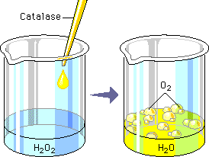
Explain what is illustrated
Was this a chemical change or physical change?
How do you know when a chemical change occurs?
How do you know when a physical change occurs?

Slide 10
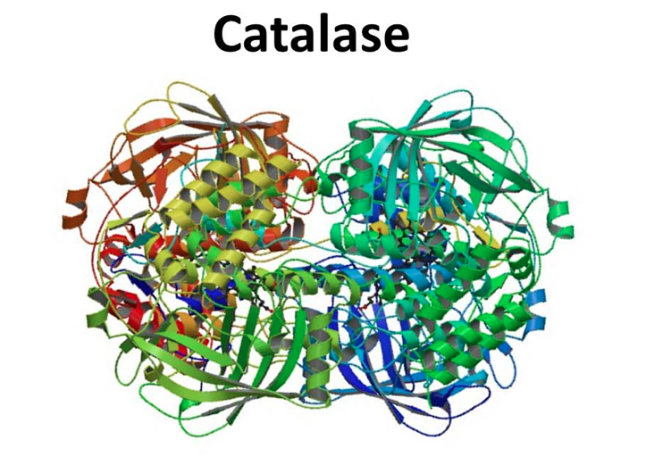
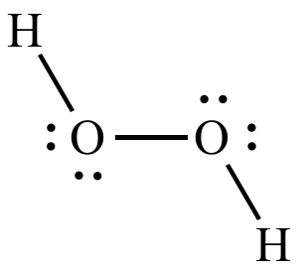
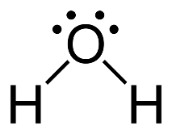
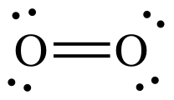
Write down 5 observations

Slide 11
Explain what’s illustrated

Slide 12
The enzyme catalase speeds up the reaction but does not get used up in the reaction
Reactants: 2 hydrogen peroxide molecules (4 oxygen atoms and 4 hydrogen atoms)
Products: 2 water molecules and 1 oxygen molecule (4 oxygen atoms and 4 hydrogen atoms)
Total amount of atoms (matter) stays the same

Slide 13
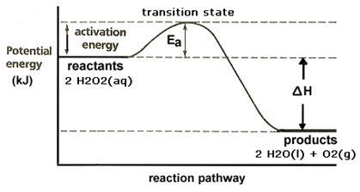
Explain what’s illustrated

Slide 14
What evidence would support the claims made in the circled portions of the illustration?

Slide 15
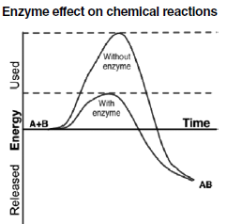
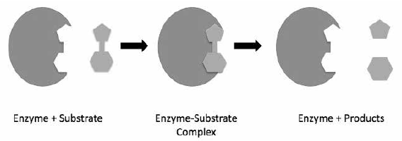
Write down 5 observations

Slide 16
Explain what’s illustrated

Slide 17
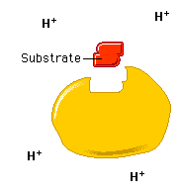
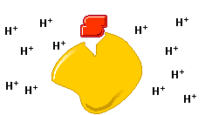
Explain what’s illustrated

Slide 18
Explain what’s illustrated
21°C
37°C

Slide 19
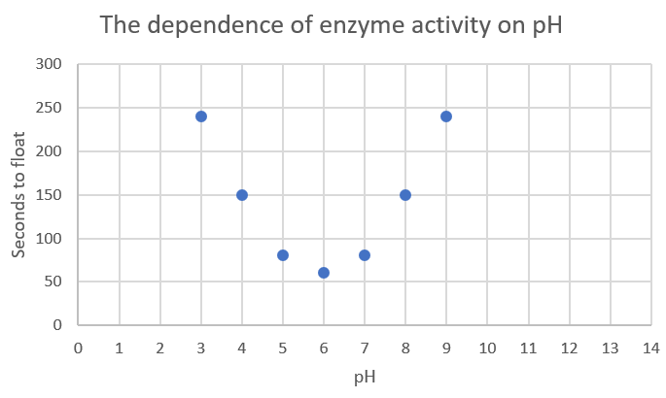
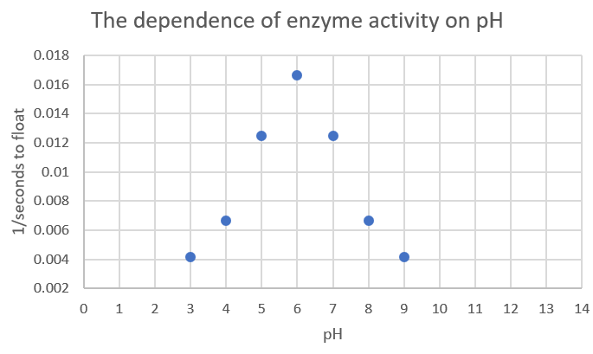
Write at least 3 similarities and 3 differences between the 2 graphs

Slide 20
What is the dependent variable of each graph?
What is the independent variable of each graph?

Slide 21
Explain how these two apparently inverse graphs are illustrating the exact same data
Which graph do you think illustrates the data best and why?

Slide 22
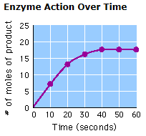
Calculate the rate of oxygen production at 15 seconds
Calculate the rate of oxygen production at 45 seconds

Slide 23
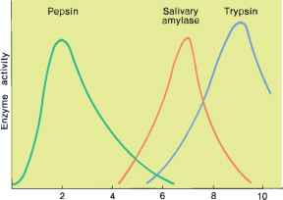
Make 5 observations (pepsin, amylase, and trypsin) are all enzymes
pH

Slide 24
Explain what’s illustrated
pH

Slide 25
Pepsin is an enzyme that cleaves proteins (polypeptides) into smaller polypeptides
Amylase is an enzyme that cleaves starch (a polysaccharide) into maltose (a disaccharide)
Trypsin is an enzyme that cleaves polypeptides into smaller peptides
pH

Slide 26
Where do you think you would find these enzymes in the human body?
What do you think the pH set point is in these parts of the body?
pH

Slide 27
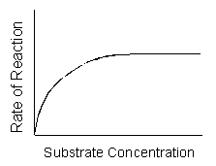
Explain why the rate of enzyme activity changes with different concentrations of substrate

Slide 28
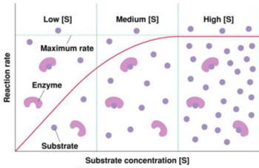
Low concentration
it takes longer for an enzyme to randomly bump into a substrate so only a few enzymes are catalyzing a reaction
Medium concentration
it takes less time for an enzyme to randomly bump into a substrate so many enzymes are catalyzing a reaction
High concentration
enzymes randomly bump into substrate as soon as they catalyze a reaction so ALL enzymes are catalyzing reactions as fast as possible

Slide 29
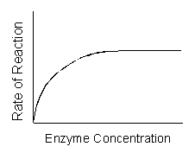
Explain why the rate of enzyme activity changes with different concentrations of enzyme
Enzyme is limiting factor (all enzymes catalyzing at capacity)
All of the enzymes are not catalyzing a reaction at all times (the substrate is the limiting factor)

Slide 30
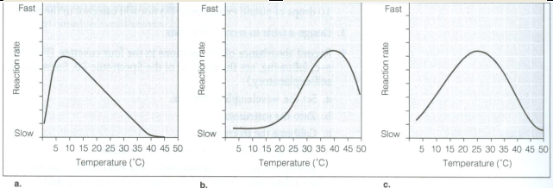
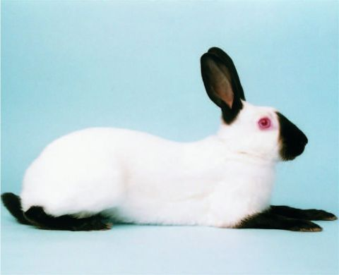
There is an enzyme that catalyzes the production of the pigment responsible for dark fur color in Siamese cats and Himalayan rabbits. This enzyme is thermolabile. Rabbits raised at 5⁰C are all black. If raised at 20⁰C, they are white with black paws, ears, and nose; they are all white when raised at 35⁰C. Which graph represent how thermolabile functions? Justify your answer.

Slide 31
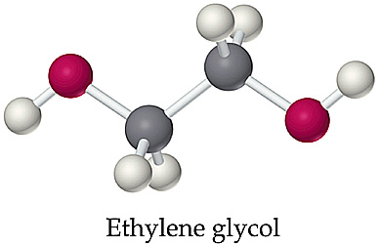
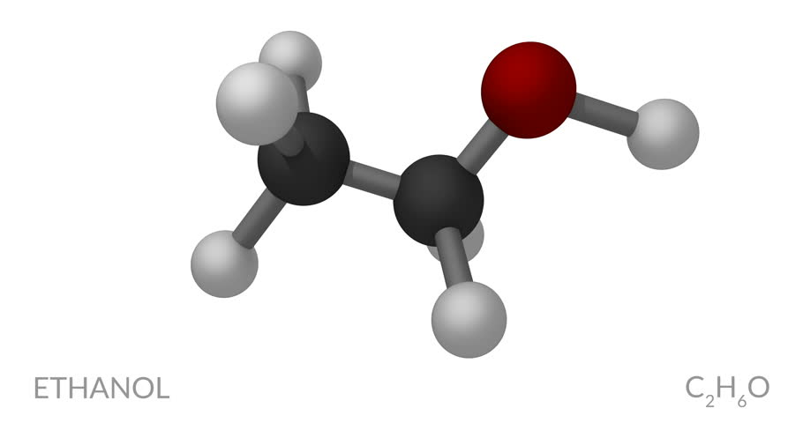
Alcohol dehydrogenase converts the poison found in alcohol containing drinks, ethanol, into the harmless compound acetaldehyde. It also converts ethylene glycol, the main component of antifreeze, into 4 very toxic compounds. If alcohol dehydrogenase is not present, the kidneys will harmlessly remove ethylene glycol. If your dog ever drinks antifreeze, you should make your dog throw-up and then give him alcohol. Explain why.

Slide 32
Which graph shows competitive inhibition? Explain what both graphs show.

Slide 33
Crosscutting concepts in science
Cause and effect: Mechanism and Prediction
How was the following demonstrated in this lab?
Empirical evidence is required to differentiate between cause and correlation and make claims about specific causes and effects.
Cause and effect relationships can be suggested and predicted for complex natural and human designed systems by examining what is known about smaller scale mechanisms within the system.

Slide 34
Crosscutting concepts in science
Energy and matter: Flows, Cycles, and Conservation
How was the following demonstrated in this lab?
Changes of energy and matter in a system can be described in terms of energy and matter flows into, out of, and within that system.
Energy drives the cycling of matter within and between systems.

Slide 35
Crosscutting concepts in science
Structure and Function
How was the following demonstrated in this lab?
The functions and properties of natural and designed objects and systems can be inferred from their overall structure, the way their components are shaped and used, and the molecular substructures of its various materials.

