Slide 1
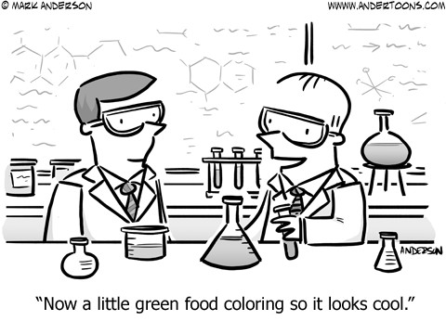
How do chemists make solutions?

Slide 2
Define concentration
The amount of stuff per unit of volume
What are common measures of concentration used by scientists?
Percent solution
Molarity
What is percent solution?
The mass of solute per the volume of solution
$$\frac{grams of solute}{100 mL of solution}$$

Slide 3
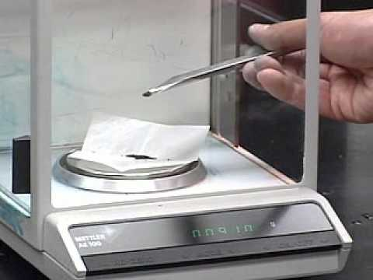
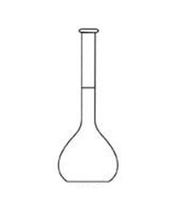
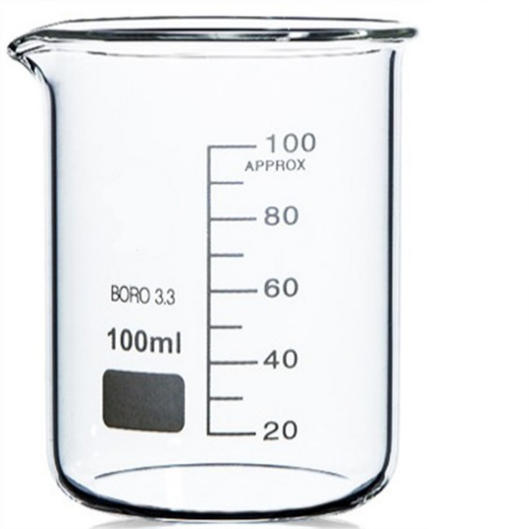
How would you make a 10% NaCl solution?
1) Mass 10 g of NaCl
0.10 X 100mL = 10mL
1g NaCl ≈ 1mL water
2) Add 10g NaCl to a beaker (preferably to a volumetric flask)
100 ML

Slide 4
3) Add water up to the 100 mL mark
***It is important to understand that the NaCl has volume. This is why we add water to NaCl up to 100mL and not NaCl to 100mL of water.
100 ML
How does this process result in a 10% NaCl solution?
Technically, it doesn’t!
We have a 10% solution by weight to volume, but 10% solution is pretty close to being an accurate description

Slide 5
NaCl is approximately 10% of the weight of the solution because 1 mL of water equals 1 gram, but dissolving a solute can cause a slight increase or decrease in the volume of the solvent (in this case water).

Slide 6
Define mole
6.02 X 10²³ atoms or molecules (abbreviated mol)
Recall that atoms are unimaginably small. This means we need an unimaginably large number of atoms to see them.
A mole is like a dozen or a ream. We buy eggs by the dozen (12) and paper by the ream (500). We measure atoms by the mol (6.02 X 10²³ )

Slide 7
Define molarity
Moles per liter $\frac{mol}{L}$ abbreviated M (a capital ‘m’)
It is a measure of concentration, just like percent solution

Slide 8
How would you make 100mL of a 5% solution from a 25% stock solution?
C₁ X V₁ = C₂ X V₂
25%
X
5%
100mL
$$25\% × X=5\%× 100mL$$
$$\frac{1}{25\%}×\frac{25\%}{1} × \frac{X}{1}=\frac{5\%}{1}× \frac{100mL}{1}×\frac{1}{25\%}$$
$$X=\frac{5\%×100mL}{25\%}$$
$$X=20 mL$$

Slide 9
How would you make 100mL of a 5% solution from a 25% stock solution?
C₁ X V₁ = C₂ X V₂
25% Stock solution
25%
X
5%
100mL
$$X=20 mL$$
C₁ X V₁ = C₂ X V₂
25% Stock solution
25% X 20 mL = 5% X 100 mL
500 % · mL
=
500 % · mL
5% solution

Slide 10
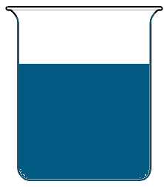
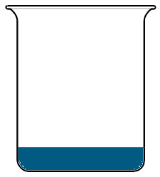
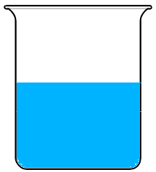
How would you make 100mL of a 5% solution from a 25% stock solution?
C₁ X V₁ = C₂ X V₂
25% Stock solution
25%
X
5%
100mL
$$X=20 mL$$
20 mL
1) Determine the amount of stock solution you need
2) Pour the appropriate amount of stock solution into a beaker
25% Stock solution
3) Add distilled water to the appropriate volume
100 mL
5% solution

Slide 11
How would you make 100mL of a 0.2M solution from a 0.8M stock solution?
C₁ X V₁ = C₂ X V₂
0.8M
X
0.2M
100mL
$$0.8M × X=0.2M× 100mL$$
$$\frac{1}{0.8M}×\frac{0.8M}{1} × \frac{X}{1}=\frac{0.2M}{1}× \frac{100mL}{1}×\frac{1}{0.8M}$$
$$X=\frac{0.2M×100mL}{0.8M}$$
$$X=25 mL$$

Slide 12
How would you make 100mL of a 0.2M solution from a 0.8M stock solution?
C₁ X V₁ = C₂ X V₂
0.8M
X
0.2M
100mL
$$X=25 mL$$
C₁ X V₁ = C₂ X V₂
0.8M Stock solution
0.8M X 25 mL = 0.2M X 100 mL
20 M · mL
=
20 M · mL

Slide 13
How would you make 100mL of a 0.2M solution from a 0.8M stock solution?
C₁ X V₁ = C₂ X V₂
0.8M Stock solution
0.8M
X
0.2M
100mL
$$X=25 mL$$
25 mL
1) Determine the amount of stock solution you need
2) Pour the appropriate amount of stock solution into a beaker
0.8M Stock solution
3) Add distilled water to the appropriate volume
100 mL
0.2M solution

Slide 14
0.8M Stock solution
0.2M solution
0.8M Stock solution
Compare the concentration of the first 2 solutions?
They are the same!
Compare the number or atoms in the first 2 solutions
The first one has many more atoms because it has a greater volume

Slide 15
25 mL
100 mL
0.8M Stock solution
0.2M solution
0.8M Stock solution
Compare the concentration of the 2nd and 3rd solutions?
The 3rd solution is less concentrated (4 x’s less!)
Compare the number or atoms in the 2nd and 3rd solutions
They are the same! Remember that we added distilled water to the 2nd solution

