Slide 1
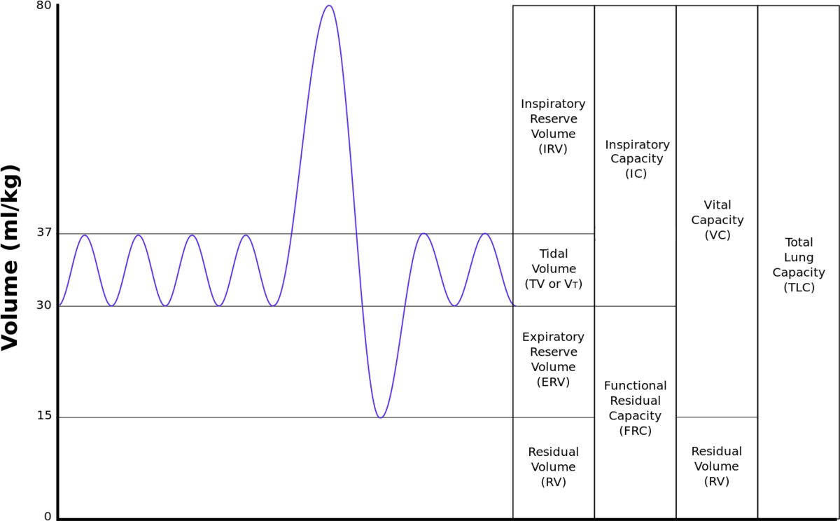
How do physiological changes affect minute volume?

Slide 2
What were some strengths of the way you planned or carried out your investigation?
(What made it scientific?)

Slide 3
What were some weaknesses of the way you planned and carried out your investigation?
(What made it less scientific?)

Slide 4
What rules should we make in order to ensure that our next investigation is scientific?

Slide 5
An observation is a descriptive statement about a natural phenomenon.
An inference is an interpretation
of an observation.
Tidal volume increased by 250mL after hypoventilation
Is this an observation or an inference? Explain how you now.

Slide 6
Minute ventilation increased because of a decrease in blood pH
Is this an observation or an inference? Explain how you know.

Slide 7
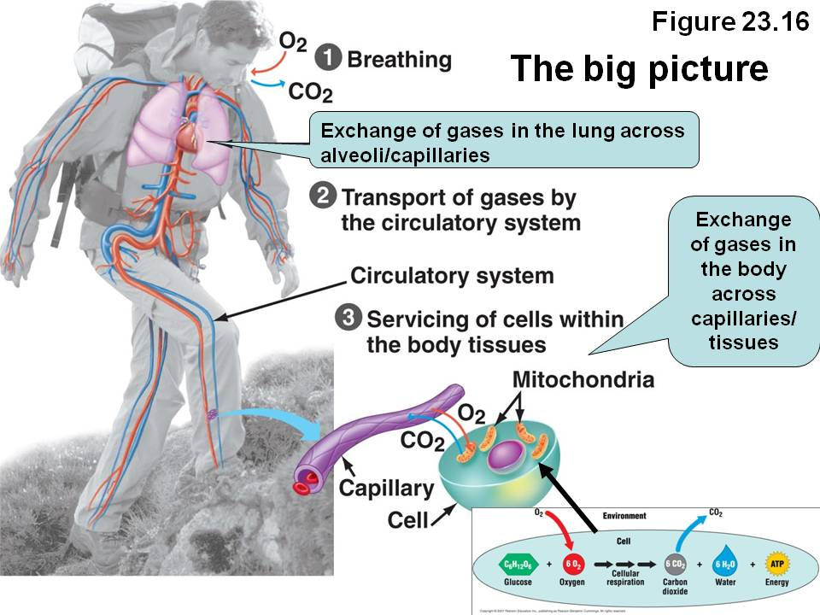

Slide 8
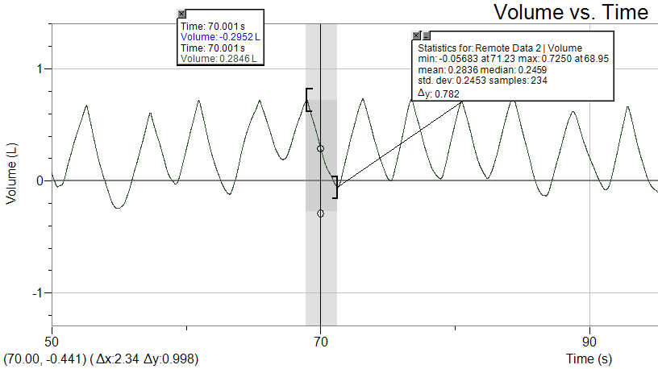
What is the tidal volume?
0.782L or 0.998L (0.782L is the more accurate value)

Slide 9
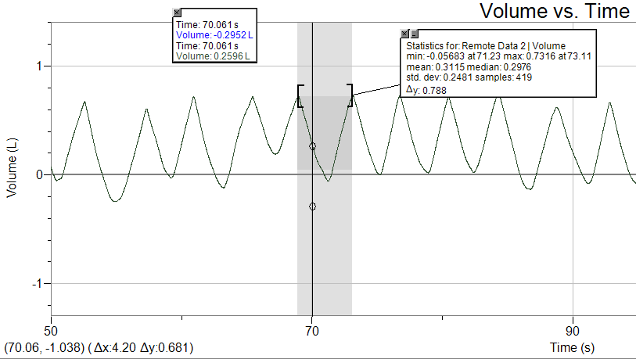
Calculate the ventilation rate for the time highlighted (breaths/minute)
One breath equals 4.2sec
$$\frac{1 Breath}{4.2sec}$$

Slide 10
Calculate the ventilation rate for the time highlighted (breaths/minute)
One breath equals 4.2sec
$$\frac{1 Breath}{4.2sec}×\frac{60sec}{1minute}=14.3breaths/minute$$

Slide 11
Calculate the minute volume of the highlighted section
$$\frac{0.788L}{Breath}×\frac{Breath}{4.2sec}×\frac{60sec}{min}$$
=11.3L/min

Slide 12
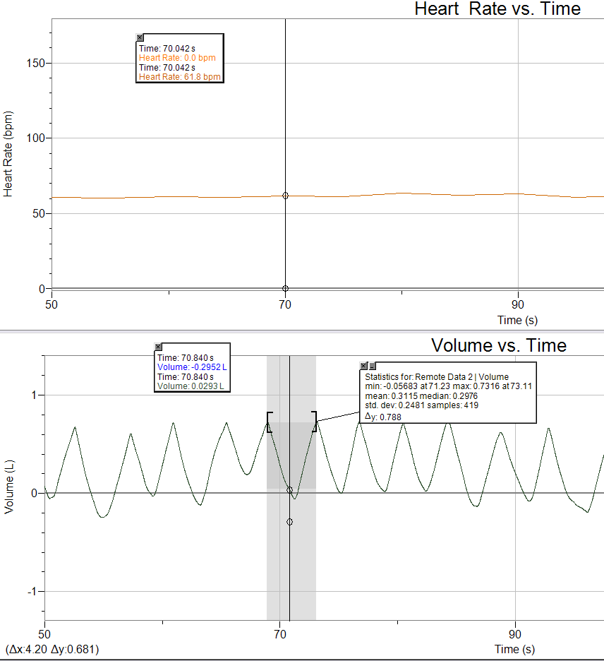
What is the heart rate and minute volume at 70 seconds?

Slide 13
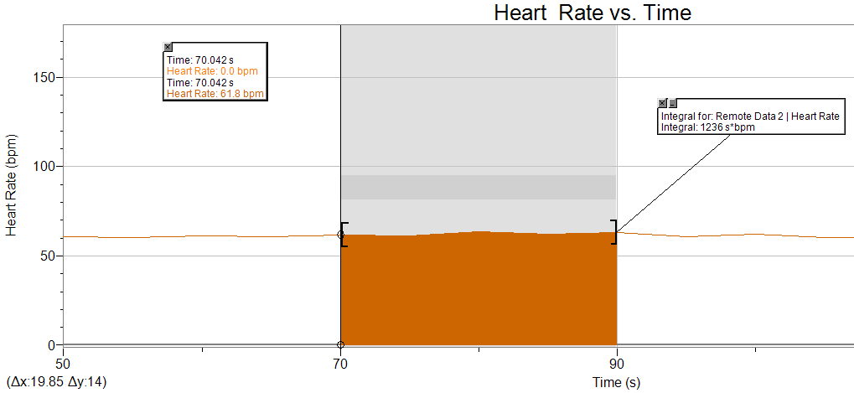
What is the average heart rate from 70 to 90 seconds?
$$\frac{1236s∗bpm}{19.85s}$$
=62.3bpm

Slide 14
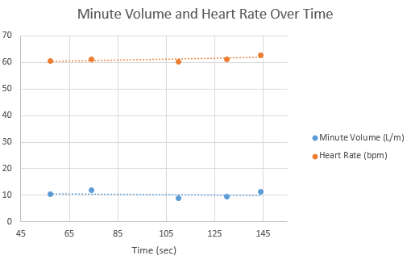
If we want to know how respiration is changing, we calculate minute volume. Explain why knowing tidal volume is insufficient for knowing how respiration is changing and why knowing ventilation rate is insufficient.
The graph above represents the control condition. Explain why the data is consistent with this claim.
Explain why we need a control group

Slide 15
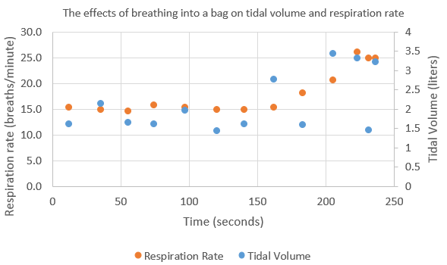
Write down 5 observations about the graph to the right

Slide 16
How does breathing into a bag affect tidal volume and ventilation rate?
What is happening to the amount of oxygen in the bag over time?
What is happening to the amount of carbon dioxide in the bag over time?
Why is the amount of carbon dioxide and oxygen in the bag changing?

Slide 17
Let’s imagine a situation where we could keep the body supplied with an adequate supply of oxygen by alternative means. Justify why breathing into a bag would increase tidal volume and ventilation rate?

Slide 18
If you started to hypoventilate, predict what would happen to the following and explain why:
Cellular respiration
Blood O₂ concentration
Blood CO₂ concentration
If you started to hyperventilate, predict what would happen to the following and explain why:
Cellular respiration
Blood O₂ concentration
Blood CO₂ concentration

Slide 19
Crosscutting concepts in science
Patterns
How was the following demonstrated in this lab?
Different patterns may be observed at each of the scales at which a system is studied and can provide evidence for causality in explanations of phenomena.
Mathematical representations are needed to identify some patterns.
Empirical evidence is needed to identify patterns.

Slide 20
Crosscutting concepts in science
Cause and effect: Mechanism and Prediction
How was the following demonstrated in this lab?
Empirical evidence is required to differentiate between cause and correlation and make claims about specific causes and effects.
Changes in systems may have various causes that may not have equal effects.

Slide 21
Crosscutting concepts in science
Scale, Proportion, and Quantity
How was the following demonstrated in this lab?
The significance of a phenomenon is dependent on the scale, proportion, and quantity at which it occurs.
Some systems can only be studied indirectly as they are too small, too large, too fast, or too slow to observe directly.

Slide 22
Crosscutting concepts in science
Systems and System Models
How was the following demonstrated in this lab?
When investigating or describing a system, the boundaries and initial conditions of the system need to be defined and their inputs and outputs analyzed and described using models.

Slide 23
Crosscutting concepts in science
Energy and Matter: Flows, Cycles, and Conservation
How was the following demonstrated in this lab?
Changes of energy and matter in a system can be described in terms of energy and matter flows into, out of, and within that system

Slide 24
Crosscutting concepts in science
Structure and Function
How was the following demonstrated in this lab?
The functions and properties of natural and designed objects and systems can be inferred from their overall structure, the way their components are shaped and used, and the molecular substructures of its various materials.

Slide 25
Crosscutting concepts in science
Stability and Change
How was the following demonstrated in this lab?
Much of science deals with constructing explanations of how things change and how they remain stable
Change and rates of change can be quantified and modeled over very short or very long periods of time. Some system changes are irreversible
Feedback (negative or positive) can stabilize or destabilize a system.

