Slide 1
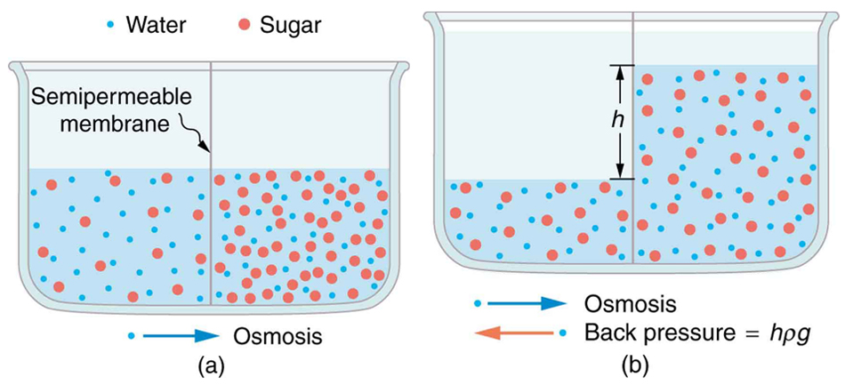
Diffusion and Osmosis: What affects the rate of osmosis?

Slide 2
What were some strengths of the way you planned or carried out your investigation?
(What made it scientific?)

Slide 3
What were some weaknesses of the way you planned and carried out your investigation?
(What made it less scientific?)

Slide 4
What rules should we make in order to ensure that our next investigation is scientific?

Slide 5
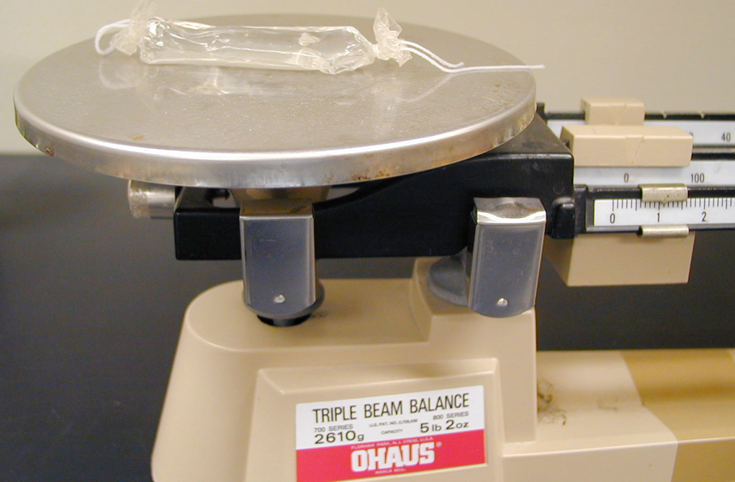
An observation is a descriptive statement about a natural phenomenon.
An inference is an interpretation
of an observation.
The mass of the ‘cell’ is 11 grams
Is this an observation or inference?

Slide 6
An observation is a descriptive statement about a natural phenomenon.
An inference is an interpretation
of an observation.
The mass of the ‘cell’ increased 2 grams
Is this an observation or inference?

Slide 7
An observation is a descriptive statement about a natural phenomenon.
An inference is an interpretation
of an observation.
Water moved into the cell
Is this an observation or inference?

Slide 8
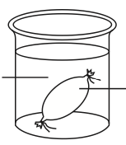
Describe the control group, what it controls for, and why it is necessary
Distilled Water
Distilled Water

Slide 9
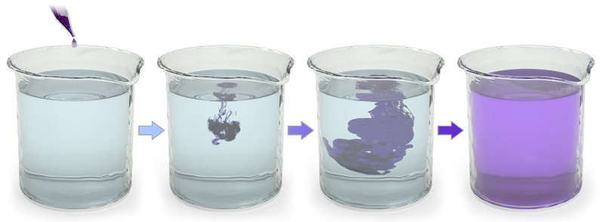
Describe what happened

Slide 10
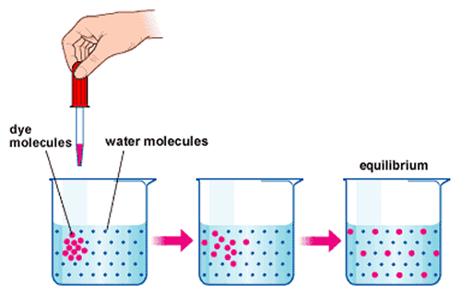
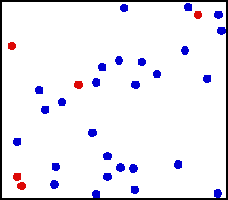
Diffusion is the net movement of a substance from a high concentration to a relatively low concentration
Explain why diffusion happens (address energy in your explanation)

Slide 11
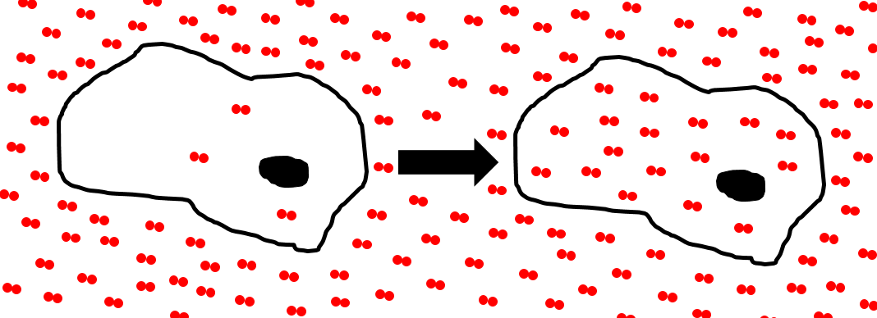
Describe what happened
Time
What is this process called?
Explain why this did or did not cost the cell energy
Plasma membrane
Solute

Slide 13
What properties can you infer the solute has?
Time
Explain why substances with these properties are permeable to the plasma membrane
Plasma membrane
Solute

Slide 14
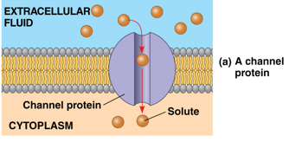
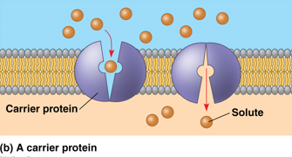
What kind of transport is shown in figure (a)?
How do you know?
What kind of transport is shown in figure (b)?
How do you know?
Explain why this did or did not cost the cell energy

Slide 15
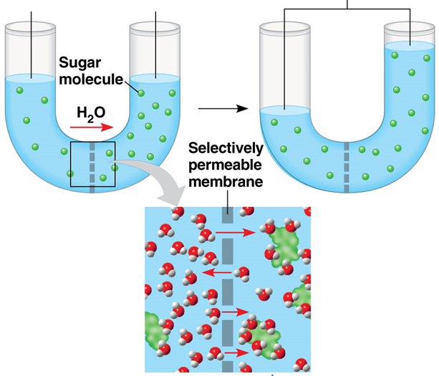
Describe what happened
Time
What is this process called?
What kind of transport is this?
Why did the water rise?

Slide 16
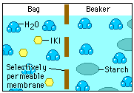
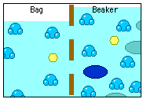
Time
Describe what happened?
Explain why it happened?

Slide 17
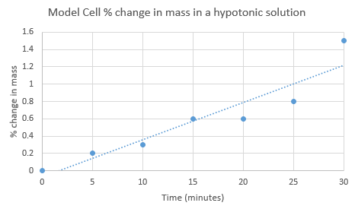
Calculate the rate of water moving into the cell at 7 minutes
Calculate the rate of water moving into the cell at 22 minutes

Slide 18
$$m=slope=rate of change=Osmotic rate$$
$$m=\frac{Δy}{Δx}=\frac{y_{2}−y_{1}}{x_{2}−x_{1}}=\frac{rise}{run}$$
Calculate the rate of water moving into the cell at 7 minutes
The difference in osmotic rate is due to estimation error
$$\frac{0.22\%}{7min}={0.031\%}/{min}$$
Calculate the rate of water moving into the cell at 22 minutes
$$\frac{0.82\%}{22min}={0.037\%}/{min}$$

Slide 19
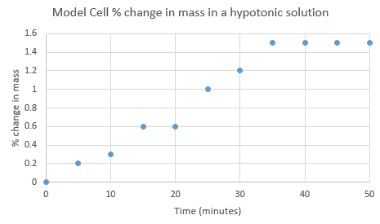
Calculate the rate of water moving into the cell at 40 minutes
$${0\%}/{min}$$
Describe and explain the movement of water over the 50 minutes of data collection

Slide 20
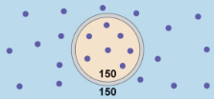
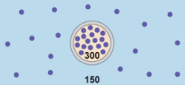
Net movement of water is zero because the cell is in an isotonic solution. In other words, there is no water movement potential gradient
Water is entering the cell because it is in a hypotonic solution. This means there is more water on the outside of the cell that is free to move across the membrane (solute sucks). As a result, the cell gets bigger

Slide 21
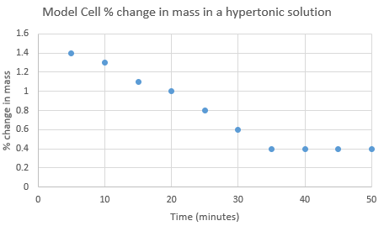
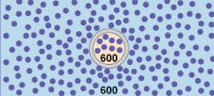
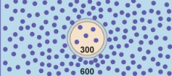
The net movement of water is out of the cell because the cell is in a hypertonic solution. This means there is more water free to move across the membrane on the inside of the cell than the outside of the cell (solute sucks). As a result, the cell shrinks.
Net movement of water is zero because the cell is in an isotonic solution. In other words, there is no water movement potential gradient

Slide 22
Explain why the percent change was used rather than change in mass

Slide 23
If these two were in a weight loss competition and both lost 50 lbs, who should win?
$$Percent ∆=\frac{Final−Initial}{Initial}×100$$
$$Percent ∆=\frac{250−300}{300}×100=−17\%$$
$$Percent ∆=\frac{100−150}{150}×100=−33\%$$
Weighs 300 lbs
Weighs 150 lbs
They both lost the same amount of weight, but the female had a larger change in weight

Slide 24
Calculate the percent change in mass for the following experimental results: model cell 1 = 7.3g initial, 8.6g final; model cell 2 = 17.4 initial, 14.9 final

Slide 25
Explain why the percent change was used rather than change in mass
Calculate the percent change in mass for the following experimental results: model cell 1 = 7.3g initial, 8.6g final; model cell 2 = 17.4 initial, 14.9 final
$\frac{8.6g−7.3g}{7.3g}×100=$0.18%
$\frac{14.9g−17.4g}{17.4g}×100=$-0.14%
YOU MUST USE % CHANGE IN MASS IN YOUR ARGUMENT AND DATA REPRESENTATION

Slide 26
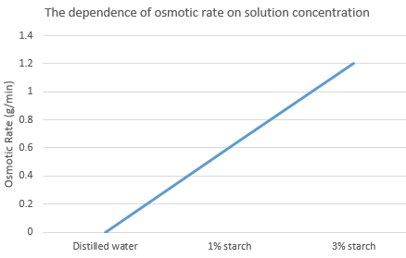
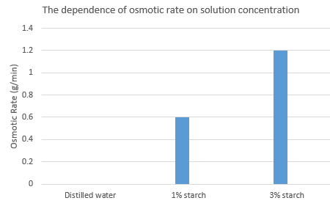
What is the rate of osmosis in the following:
Distilled water
1% starch solution
3% starch solution
0.0g/min
0.6g/min
1.2g/min
Which chart best represents the data?

Slide 27
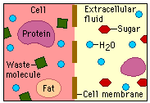
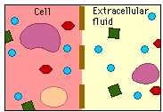
Time
Describe what happened?
Explain why it happened?

Slide 28
Time
Sugar is a polar molecule
Explain how it got into the cell and why it did or did not cost the cell energy

Slide 29
M=molarity, which is a measure of solute concentration
Arrange the beakers above in order of mass inside of cell after 30 minutes. Starting with the one with the least amount of mass. (assume they all start with the same amount of mass)

Slide 30
Explain the relative position of each cell

Slide 31
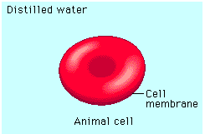
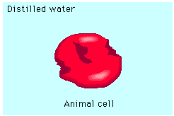
Time
Describe what happened
Explain why it happened

Slide 32
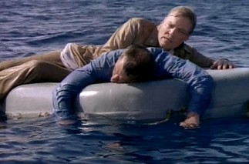
The salinity of ocean water is about 35ppt and the salinity of vertebrate blood is about 0.9ppt.
What would happen if a human drank ocean water?
Explain why

Slide 33
Crosscutting concepts in science
Patterns
How was the following demonstrated in this lab?
Different patterns may be observed at each of the scales at which a system is studied and can provide evidence for causality in explanations of phenomena.

Slide 34
Crosscutting concepts in science
Cause and effect: Mechanism and Prediction
How was the following demonstrated in this lab?
Empirical evidence is required to differentiate between cause and correlation and make claims about specific causes and effects.
Cause and effect relationships can be suggested and predicted for complex natural and human designed systems by examining what is known about smaller scale mechanisms within the system.

Slide 35
Crosscutting concepts in science
Systems and system models
How was the following demonstrated in this lab?
Models (e.g., physical, mathematical, computer models) can be used to simulate systems and interactions—including energy, matter, and information flows—within and between systems at different scales.
Models can be used to predict the behavior of a system, but these predictions have limited precision and reliability due to the assumptions and approximations inherent in models.

Slide 36
Crosscutting concepts in science
Energy and matter: Flows, Cycles, and Conservation
How was the following demonstrated in this lab?
The total amount of energy and matter in closed systems is conserved.
Changes of energy and matter in a system can be described in terms of energy and matter flows into, out of, and within that system.
Energy drives the cycling of matter within and between systems.

Slide 37
Crosscutting concepts in science
Structure and Function
How was the following demonstrated in this lab?
The functions and properties of natural and designed objects and systems can be inferred from their overall structure, the way their components are shaped and used, and the molecular substructures of its various materials.

