Slide 1
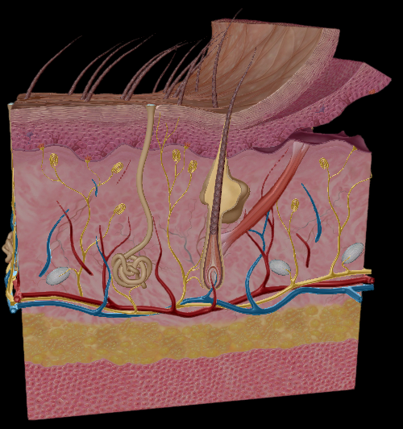
How are touch receptors distributed in the integumentary system?

Slide 2
What were some strengths of the way you planned or carried out your investigation?
(What made it scientific?)

Slide 3
What were some weaknesses of the way you planned and carried out your investigation?
(What made it less scientific?)

Slide 4
What rules should we make in order to ensure that our next investigation is scientific?

Slide 5
The error in localization of the buccal region is 1.5cm and the error of localization of the acromial region is 4.2cm because there are more Meissner and Pacinian corpuscles in the buccal region
Is this an observation or an inference? Explain how you now.

Slide 6
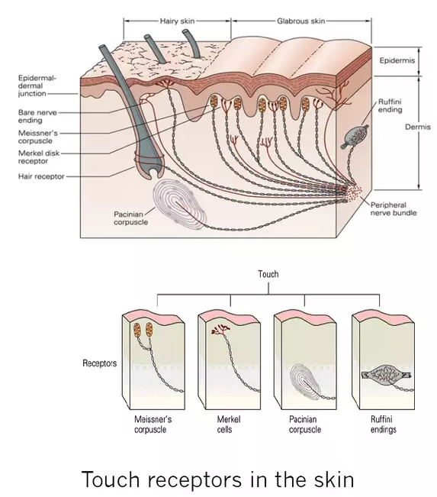
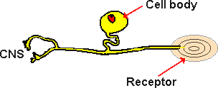

Slide 7
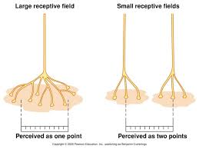

Slide 8
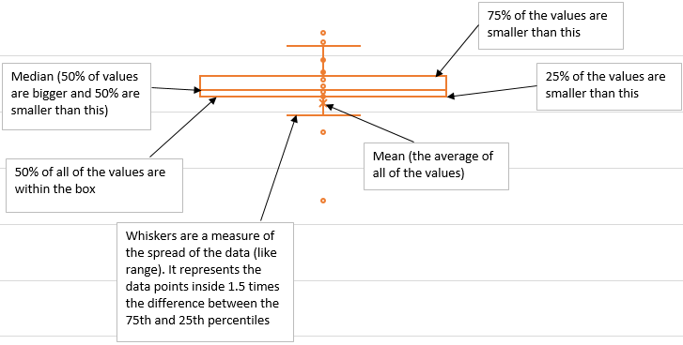

Slide 9
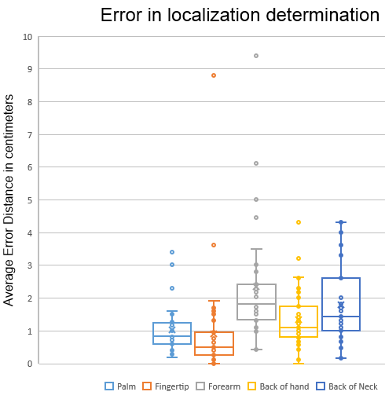
Observations

Slide 10
How are the error in localization determinations similar and different?
Which area has the best detection?
Justify your answer
Which area has the worst detection?
Justify your answer

Slide 11
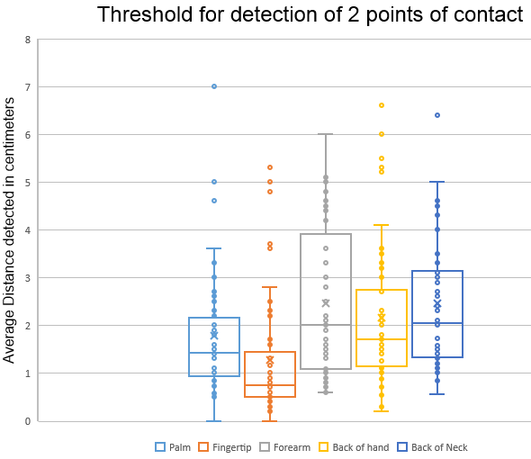
How are the different regions similar and different in two-point threshold determination and localization determination? You must justify your conclusions using specifics from the box and whiskers plots.

Slide 12
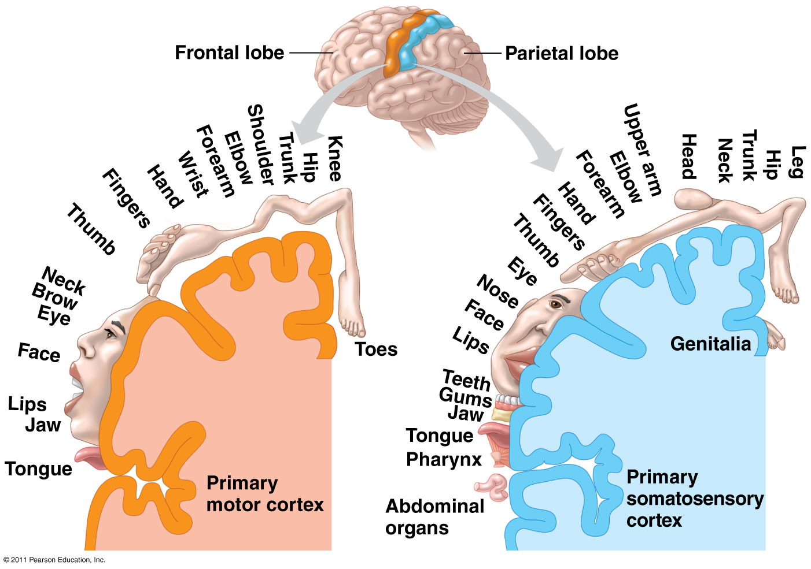
Which body regions are most sensitive?
How do you know?
Which body regions are the least sensitive?
How do you know?
Would it be possible to believe you have been touched in one area of your body while actually being touched in an area very distant from the area of perceived touching? Explain your answer.

Slide 13
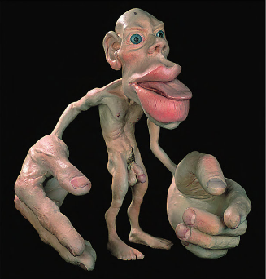
This is how we would look if our bodies reflected the relative amount of sensory cortex dedicated to each region

Slide 14
What conclusions can you draw about our ability to detect cold, pain, etc., based on the human homunculus? Justify your response.

Slide 15
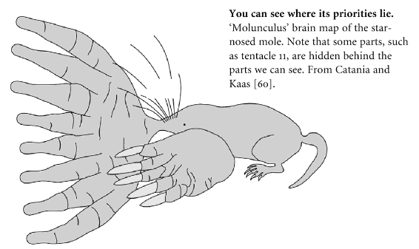
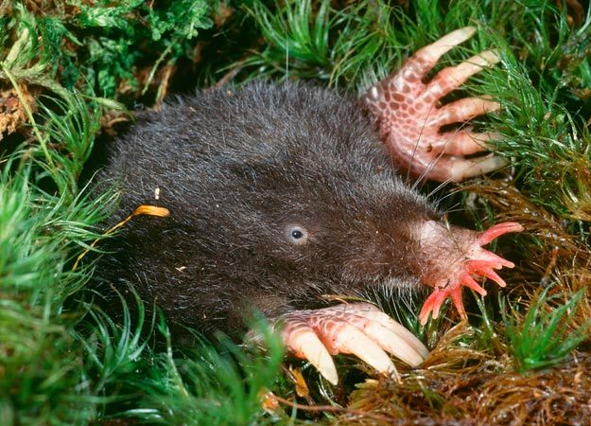
Star nosed moles are blind. They spend nearly all of their time in tunnels with no light foraging for food. They use their noses to find food.
How would a star nosed mole molunculus look? Justify your answer.

Slide 16
Speculate about why animals devote different amounts of brain real estate to different senses and areas of the body. Consider the evolutionary advantage of this fact.

Slide 17
Crosscutting concepts in science
Patterns
How was the following demonstrated in this lab?
Different patterns may be observed at each of the scales at which a system is studied and can provide evidence for causality in explanations of phenomena.
Empirical evidence is needed to identify patterns.

Slide 18
Crosscutting concepts in science
Cause and effect: Mechanism and Prediction
How was the following demonstrated in this lab?
Empirical evidence is required to differentiate between cause and correlation and make claims about specific causes and effects.

Slide 19
Crosscutting concepts in science
Structure and Function
How was the following demonstrated in this lab?
The functions and properties of natural and designed objects and systems can be inferred from their overall structure, the way their components are shaped and used, and the molecular substructures of its various materials.

